Slide 1

Dr Rahul Bagla ENT Textbook
Author
Dr. Rahul Bagla
MBBS (MAMC, Delhi) MS ENT (UCMS, Delhi)
Fellow Rhinoplasty & Facial Plastic Surgery.
Renowned Teaching Faculty
Mail: msrahulbagla@gmail.com
India

Slide 2
Acute Suppurative Otitis Media
Author
Dr Rahul Bagla

Slide 3
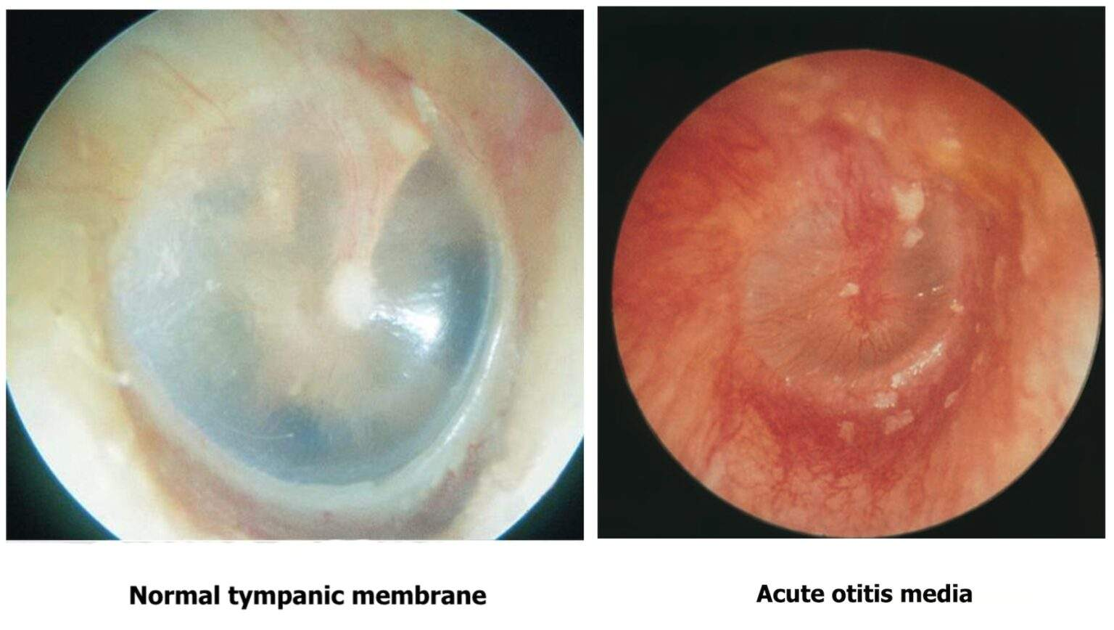
Acute Suppurative Otitis Media: A Common Ear Infection
ASOM is a rapid-onset bacterial infection of the middle ear cleft.
Most common in children aged 6–24 months due to eustachian tube anatomy.

Slide 4
Defining Acute Suppurative Otitis Media
ASOM is an acute (lasting <3 weeks) pyogenic inflammation of the middle ear cleft, including the eustachian tube, attic, and mastoid air cells.
Primarily affects children due to shorter, wider, more horizontal eustachian tubes.
Often develops behind an intact tympanic membrane but can involve perforations or ventilation tubes.

Slide 5
Link to Mastoiditis
ASOM almost always involves mastoiditis due to the continuity between the middle ear and mastoid air cells.
Acute mastoiditis differs by forming abscesses within or around the mastoid.
Early treatment of ASOM can prevent progression to severe mastoid complications.
Visuals: Image comparing healthy vs. infected mastoid air cells.

Slide 6
What Triggers ASOM?
Mostly infective, often following a viral upper respiratory infection.
Can also stem from autoimmune, neoplastic, traumatic, or metabolic disorders.
Viral infections weaken defenses, allowing bacteria to invade the middle ear.
Superinfections by fungi occur in immunocompromised individuals.
Visuals: Illustration of infection spreading to the ear.

Slide 7
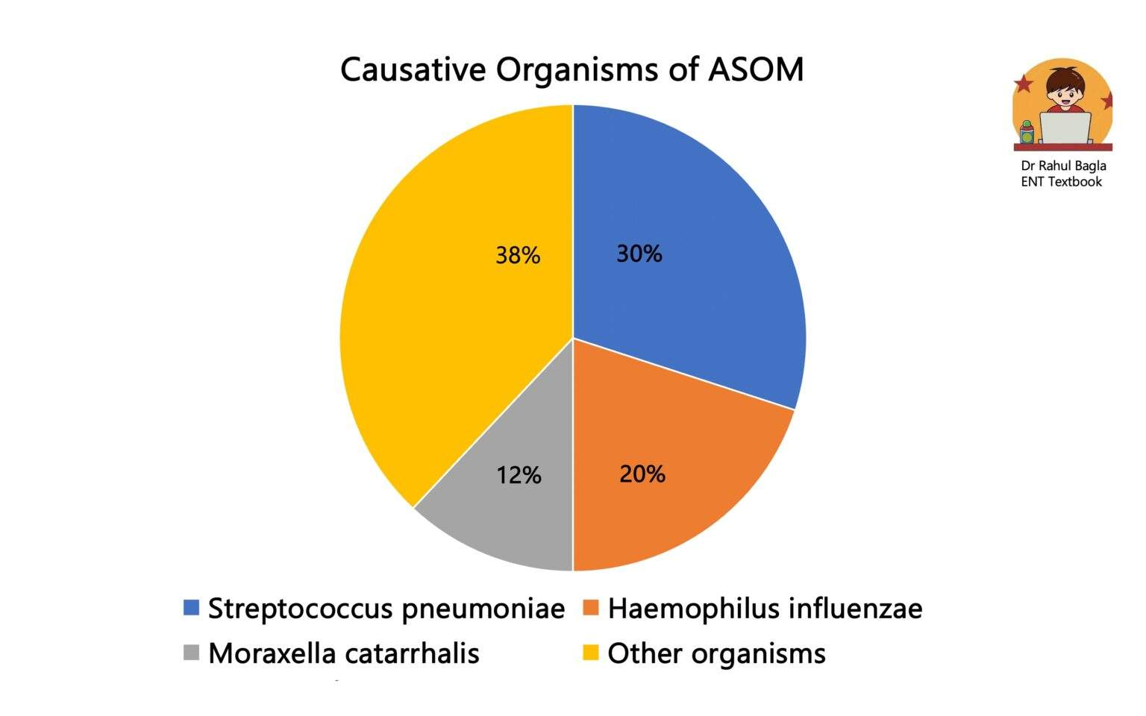
Viral and Bacterial Causes
Viruses: Respiratory syncytial virus, rhinovirus; less commonly coronavirus, influenza A, adenovirus.
Bacteria in Children: S. pneumoniae (30%), H. influenzae (20%), M. catarrhalis (12%).
Bacteria in Adults: S. pyogenes (13%), S. aureus (5%), P. aeruginosa.
18–20% of cases show no microbial growth.

Slide 8
Rare and Fungal Causes
Uncommon Bacteria: Gram-negative bacilli (e.g., Bacillus proteus, coli) from skin after trauma.
Fungi: Aspergillus and Candida species, often as superinfections in immunocompromised patients.
Fungal infections typically follow an initial viral process, complicating treatment.
Visuals: Microscope image of fungal spores.

Slide 9
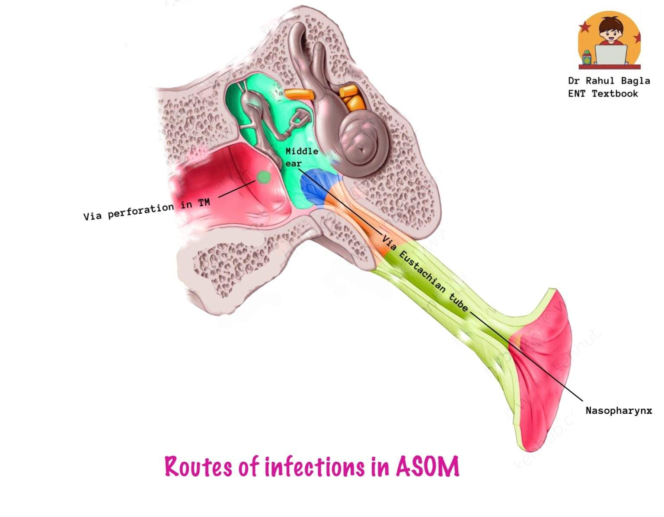
How Infection Reaches the Ear
Eustachian Tube: Most common route; bacteria travel via the tube’s lumen or lymphatics, aided by negative middle ear pressure.
External Ear: Through ventilation tubes or tympanic membrane perforations, often linked to water exposure.
Blood-Borne: Rare, inferred from viral presence in blood and middle ear.

Slide 10
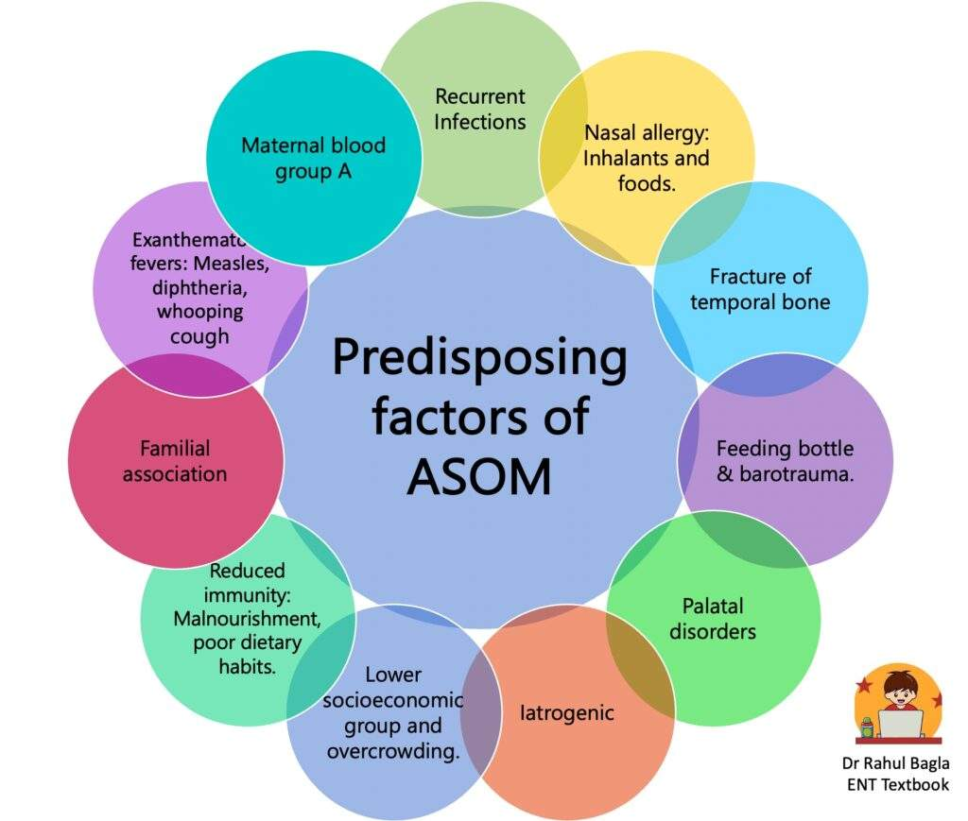
Predisposing factors
Recurrent colds, adenoiditis, tonsillitis, or sinusitis.
Nasal allergies, cleft palate, or palatal palsy.
Bottle-feeding in supine position, swimming, or barotrauma.
Low immunity, poor nutrition, or socioeconomic factors like overcrowding.
Familial tendency and maternal blood group A as risk factors.

Slide 11
Stage 1: Eustachian tube occlusion
Viral infection causes edema and hyperemia, blocking the eustachian tube.
Negative middle ear pressure leads to tympanic membrane retraction and effusion.
Symptoms: Mild hearing loss, ear fullness, mild earache, no fever.
Signs: Retracted tympanic membrane, conductive hearing loss on tuning fork tests.

Slide 12
Stage 2: Pre-suppuration
Persistent eustachian tube blockage increases negative pressure and inflammatory exudate.
Bacterial/viral invasion occurs without pus formation.
Symptoms: Severe throbbing earache, high fever, hearing loss, tinnitus.
Signs: Red, bulging tympanic membrane with “cart wheel appearance,” conductive hearing loss.

Slide 13
Stage 3: Suppuration
Bacterial growth leads to pus in the middle ear and mastoid air cells.
Tympanic membrane bulges to the point of rupture, sometimes with a nipple-like protrusion.
Symptoms: Excruciating ear pain, high fever (102–103°F), vomiting, convulsions.
Signs: Red, bulging tympanic membrane, mastoid tenderness, cloudy mastoid X-ray.

Slide 14
Stage 4: Resolution
Tympanic membrane ruptures, releasing pus and relieving symptoms.
Resolution can occur without rupture if treated early or if infection is mild.
Symptoms: Reduced earache, lower fever, improved well-being.
Signs: Serosanguinous or mucopurulent discharge, small perforation in pars tensa, subsiding hyperemia.

Slide 15
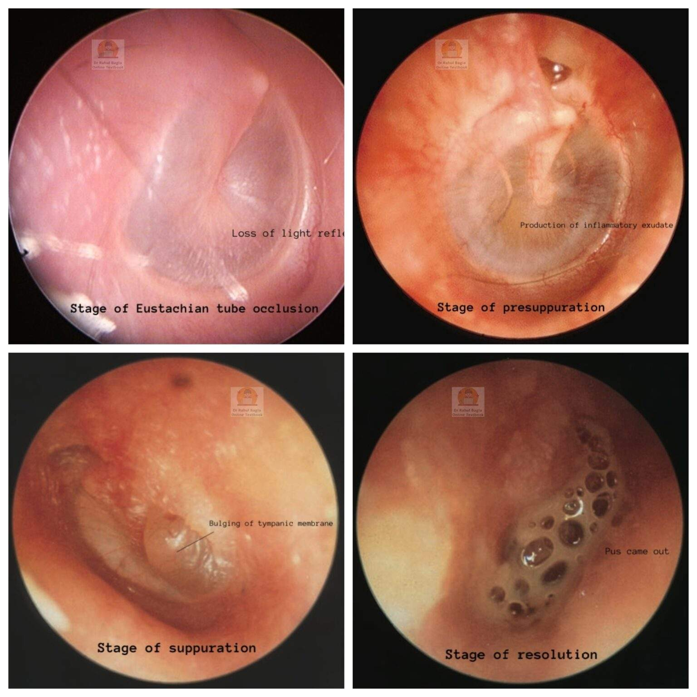
Pictures of Tympanic Membrane

Slide 16
Stage 5: Complications
If untreated, infection may spread beyond the middle ear, typically in the second week.
Complications include acute mastoiditis, subperiosteal abscess, facial paralysis, meningitis, or brain abscess.
High bacterial virulence or low patient resistance increases risk.

Slide 17
Treatment
Antibiotics for 10 days until tympanic membrane and hearing normalize.
Options:
Amoxicillin (40 mg/kg/day, first-line).
Cefaclor, Co-trimoxazole, or Erythromycin for penicillin-allergic patients.
Amoxicillin-clavulanate or Cefixime for resistant strains.
Inadequate therapy risks secretory otitis media or hearing loss.

Slide 18
Clearing the Eustachian Tube
Nasal drops (e.g., Ephedrine, Oxymetazoline) reduce eustachian tube edema.
Oral Pseudoephedrine (30 mg twice daily) or antihistamine combinations (e.g., Triominic) promote ventilation.
Decongestants are critical for children, where nasal drops are challenging to administer.

Slide 19
Supportive Care for ASOM
Analgesics/Antipyretics: Paracetamol for pain and fever relief.
Ear Toilet: Clean discharge to prevent secondary infections.
Dry Local Heat: Reduces ear pain.
These measures improve comfort and support recovery alongside antibiotics.

Slide 20
Surgical Intervention: Myringotomy
Myringotomy involves incising the tympanic membrane to drain pus or fluid.
Indications:
Bulging drum with severe pain.
Persistent conductive hearing loss despite antibiotics.
Effusion lasting beyond 12 weeks.
Prevents complications and restores hearing.

Slide 21
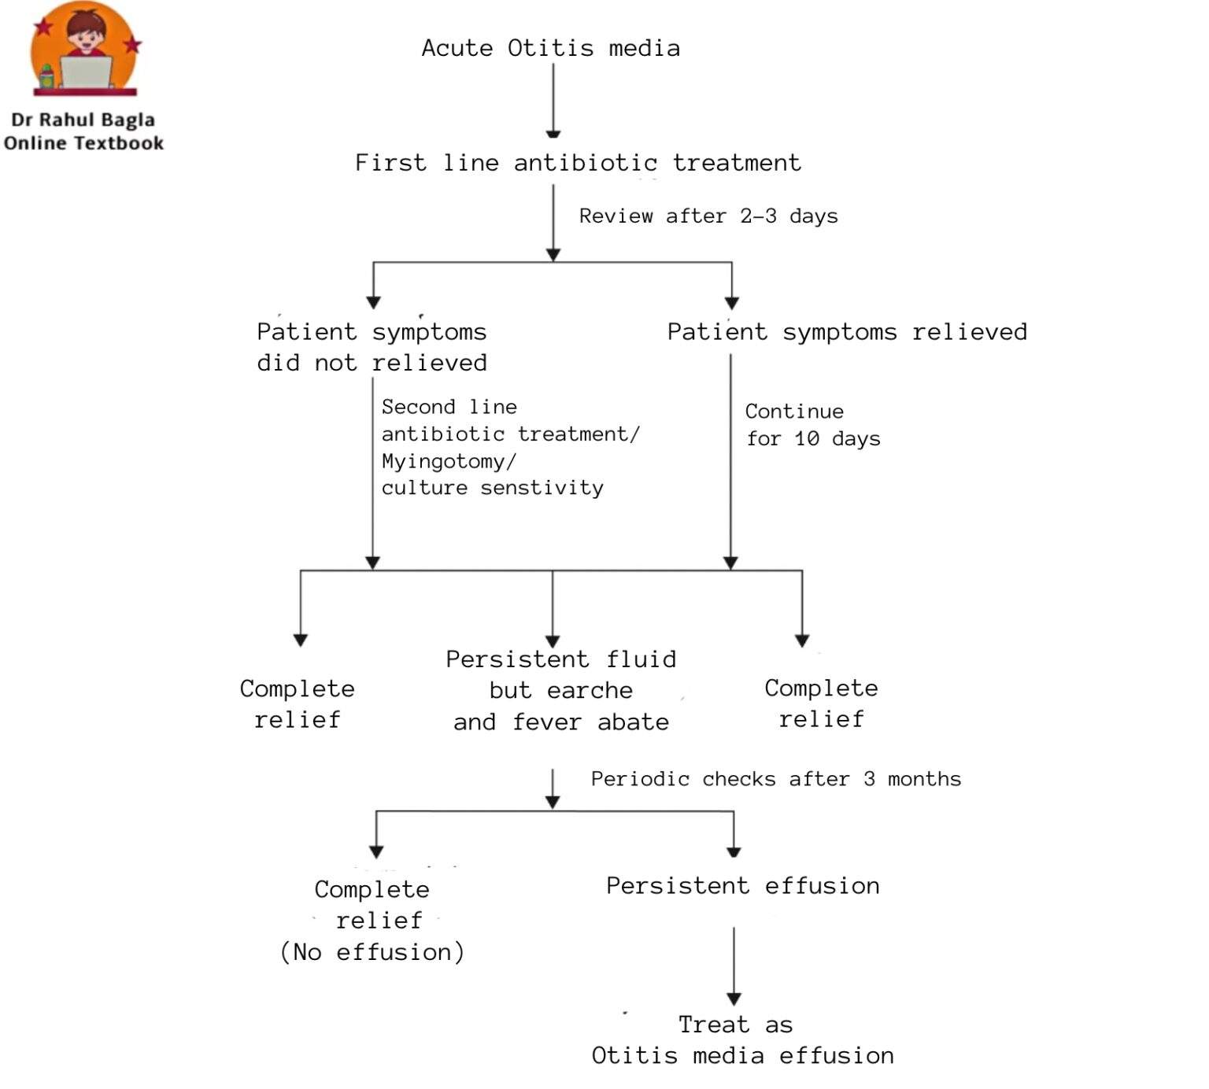
Flowchart of Treatment

Slide 22
Preventing and Managing ASOM
ASOM is common in children, driven by eustachian tube anatomy and infections.
Early antibiotic treatment and decongestants prevent complications.
Myringotomy is effective for severe cases.
Awareness of symptoms and risk factors ensures timely care for healthy ears.

Slide 23


